Slide 1
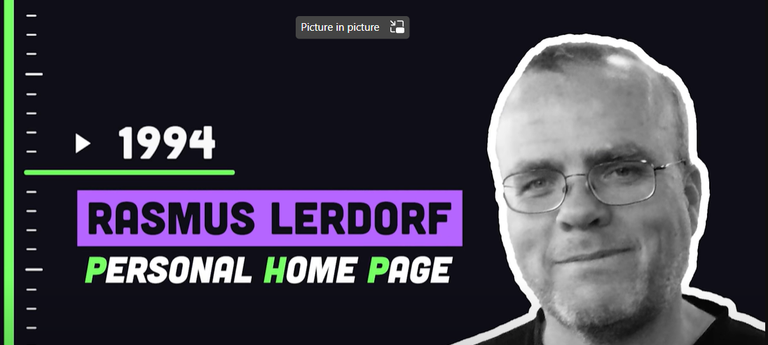
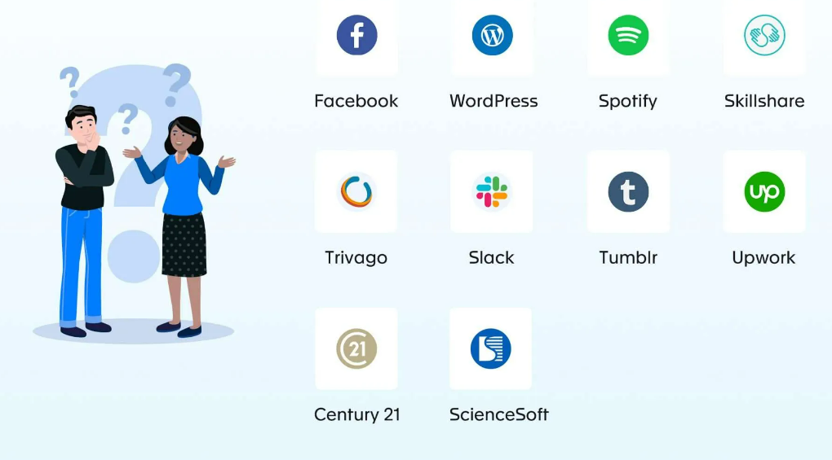
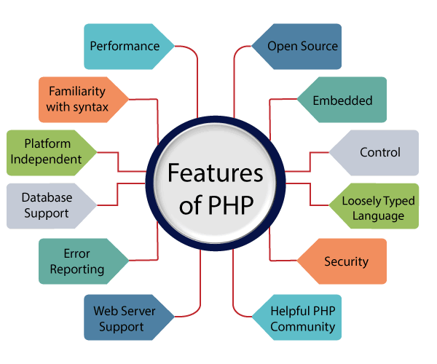
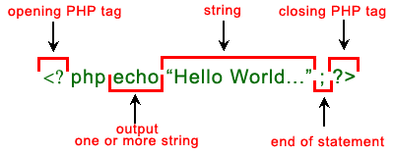
PHP
hypertext preprocessor
Personal home page
https://www.restapitutorial.com/httpstatuscodes.html

Slide 2
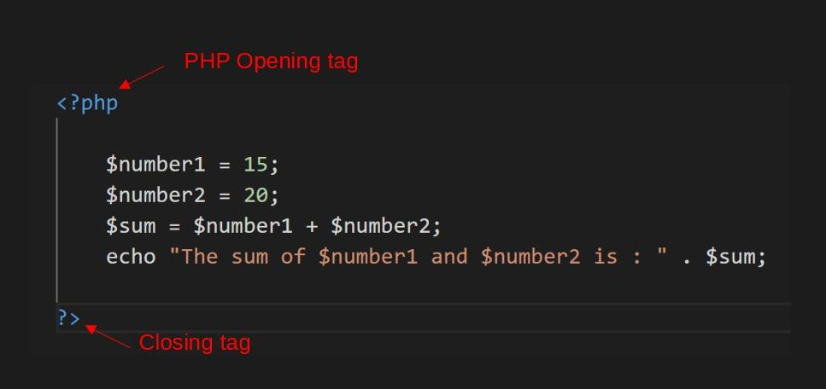
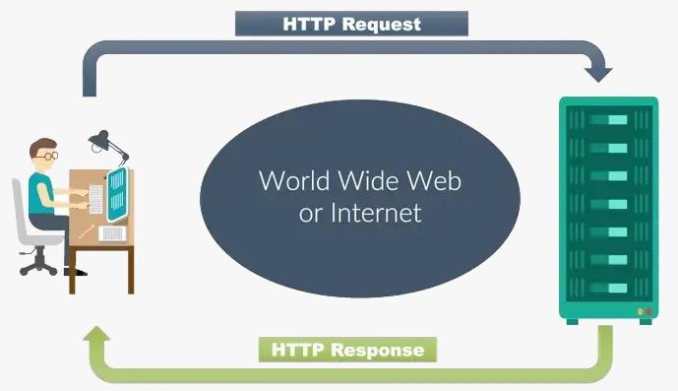
php:Hypertext Preprocessor
Advantages of PHP :
Large choice of available specialists
Plentiful documentation
Improved loading speed
Wide selection of databases
Inexpensive open-source software
Cheaper hosting services
Excellent combinability with HTML
Good flexibility
Compatibility with cloud services
مجموعة كبيرة من المتخصصين المتاحين
وثائق وفيرة
تحسين سرعة التحميل
مجموعة واسعة من قواعد البيانات
برامج مفتوحة المصدر غير مكلفة
خدمات استضافة أرخص
قابلية دمج ممتازة مع HTML
مرونة جيدة
التوافق مع الخدمات السحابية

Slide 3
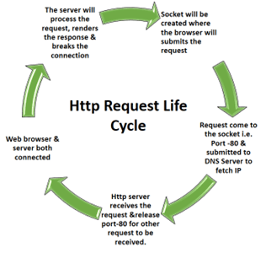
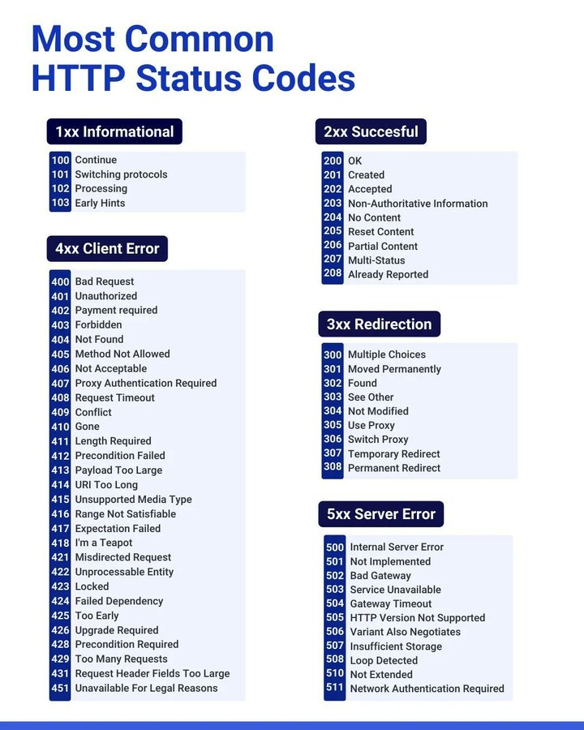
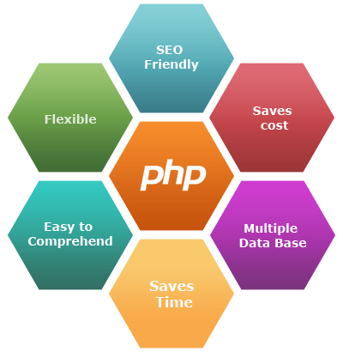

Slide 4
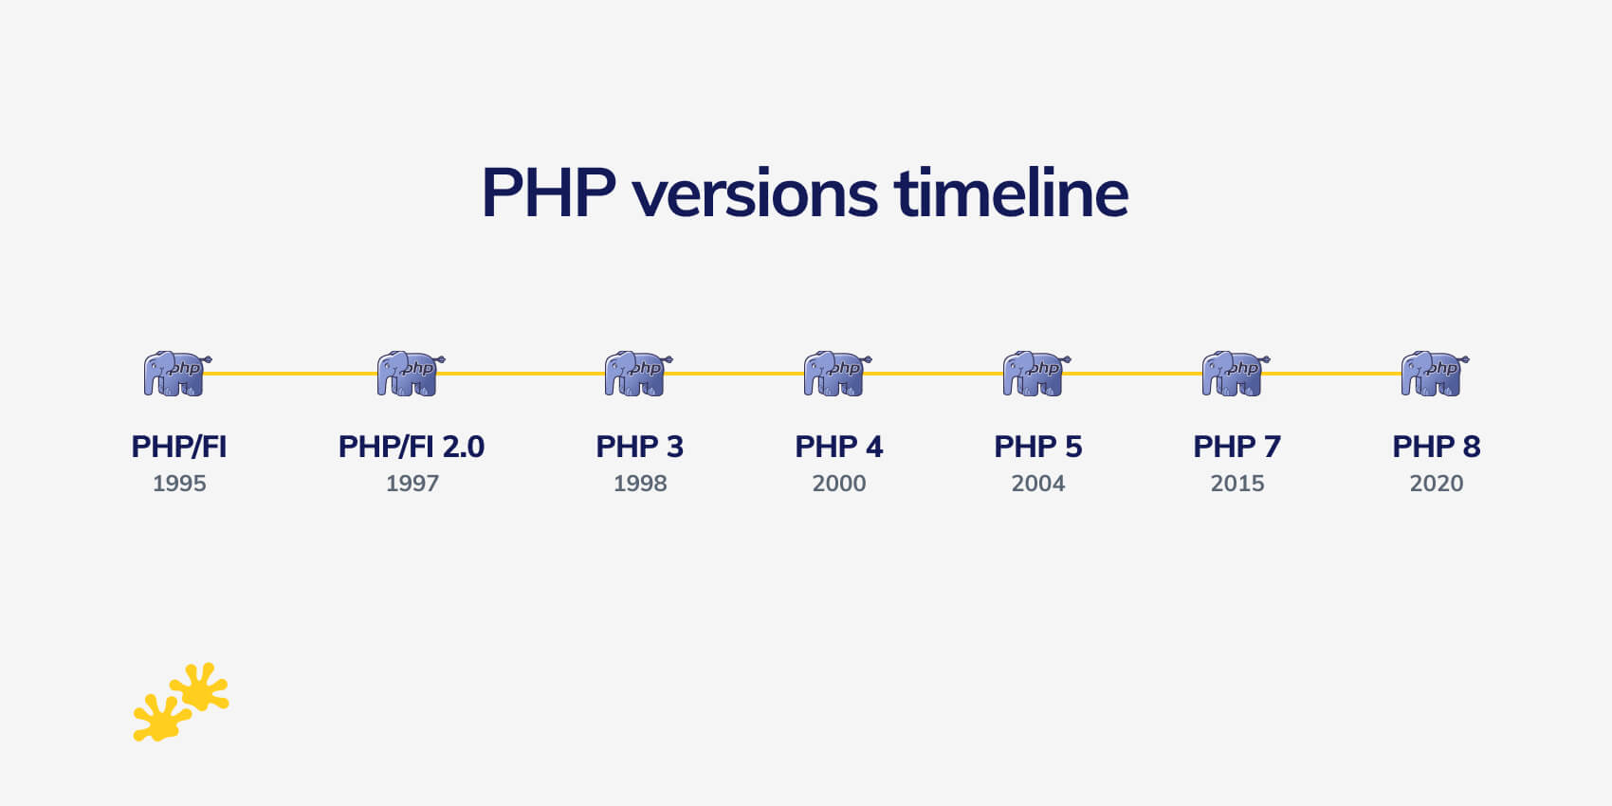
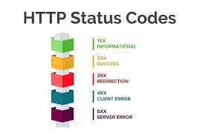
PHP
PHP Syntax
<?php
// PHP code goes here
?>

Slide 5
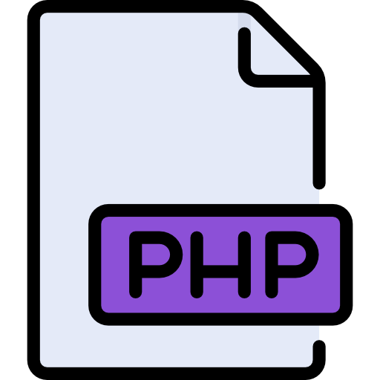
PHP stands for Hypertext Preprocessor( which was changed from the initial name of “Personal Home Page”).
Most popular server-side scripting language.
PHP is mainly used in conjunction with HTML code,web content management system, web template systems.
The PHP language is processed by the server or the Common Gateway Interface(CGI).
In 1996, the code got a complete makeover and turned into a programming language from a suite of tools.
Why do we use php?

